Slide 1
Digital Signal Processing
ECA0908
ERROR ANALYSIS TASK
Thilak (192412666)

Slide 2
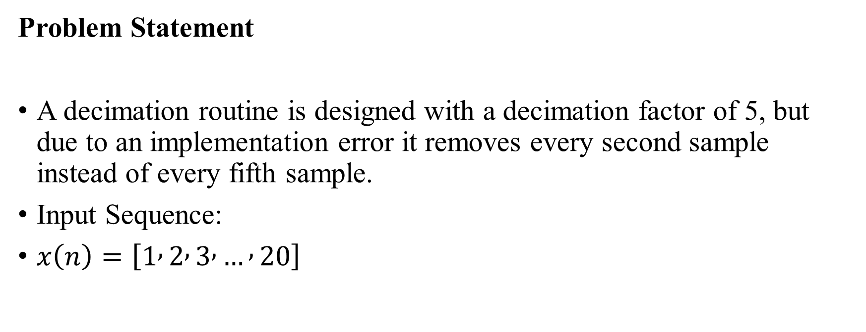
A decimation routine removes every second sample although the decimation factor is 5.Using the input sequence [1,2,3,...,20], determine the incorrect and correct outputs.
Problem Statement
A decimation routine is designed with a decimation factor of 5, but due to an implementation error it removes every second sample instead of every fifth sample.
Input Sequence:
$x\left(n\right)=\left[1 , 2 , 3 , … , 20\right]$

Slide 3
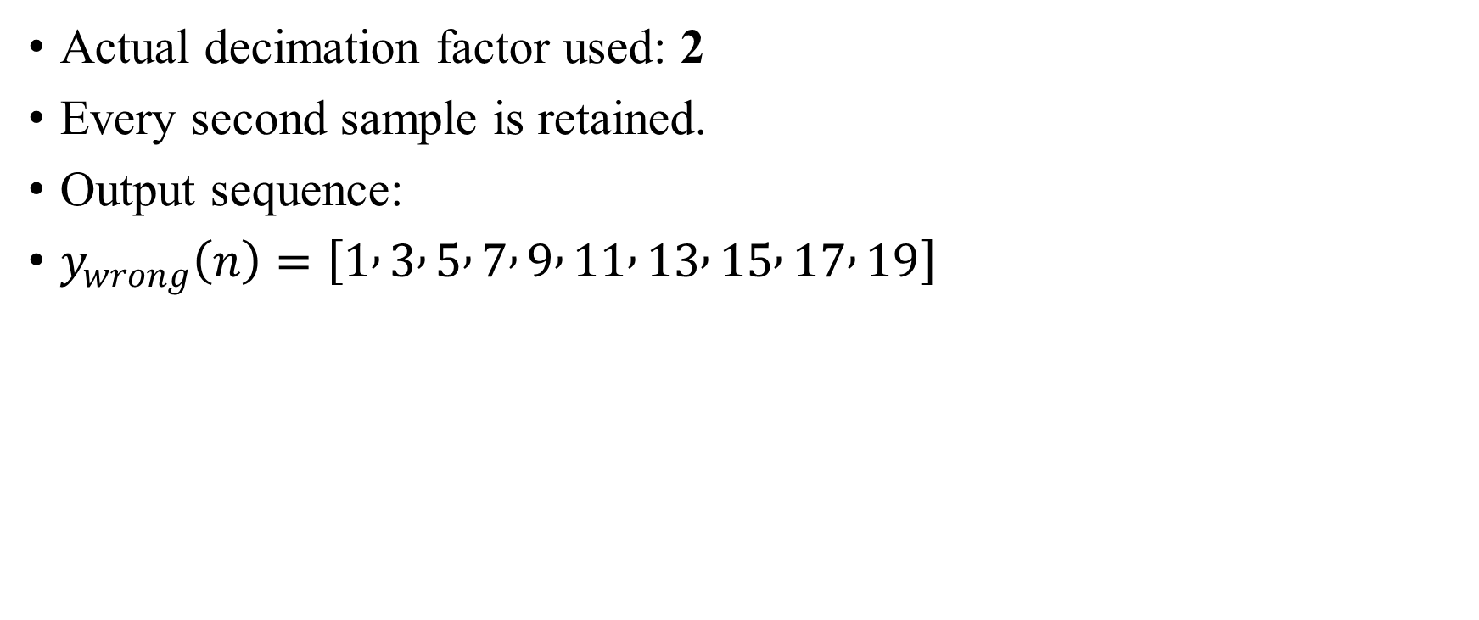
Incorrect Decimation
Actual decimation factor used: 2
Every second sample is retained.
Output sequence:
$y_{wrong}\left(n\right)=\left[1 , 3 , 5 , 7 , 9 , 11 , 13 , 15 , 17 , 19\right]$

Slide 4
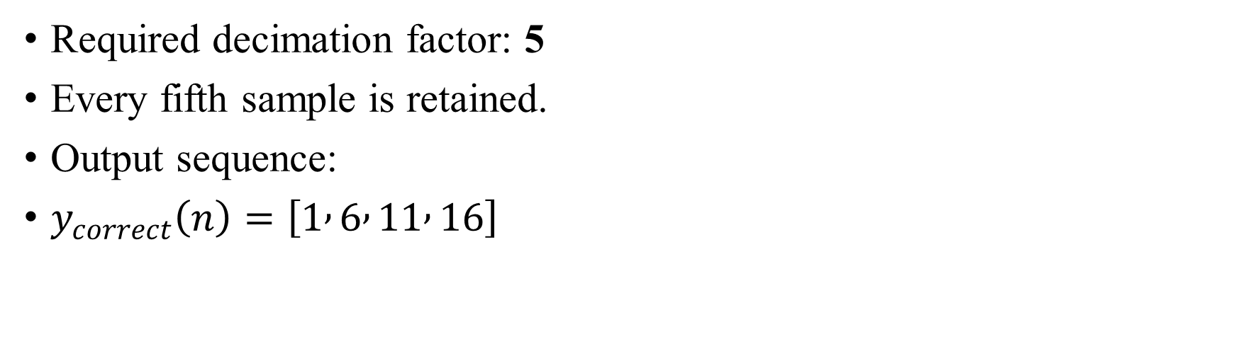
Correct Decimation
Required decimation factor: 5
Every fifth sample is retained.
Output sequence:
$y_{correct}\left(n\right)=\left[1 , 6 , 11 , 16\right]$

Slide 5
Comparison
Incorrect Output (D = 2) [1,3,5,7,9,11,13,15,17,19] | Correct Output (D = 5) [1,6,11,16]

Slide 6
Observation
Incorrect routine retains 10 samples.
Correct routine retains only 4 samples.
The sampling-rate reduction is not achieved as intended when the wrong decimation factor is used.

Slide 7
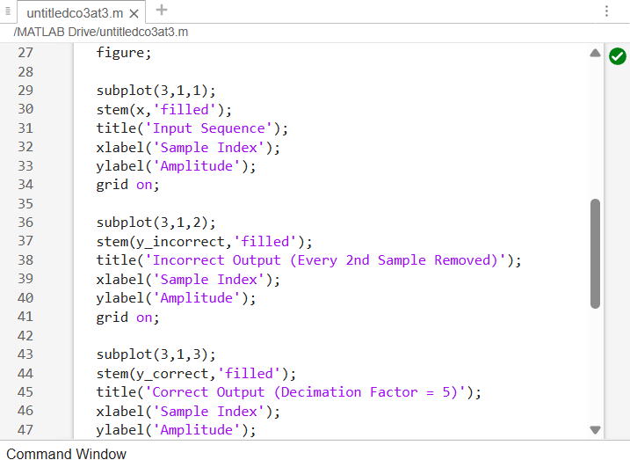
Coding

Slide 8
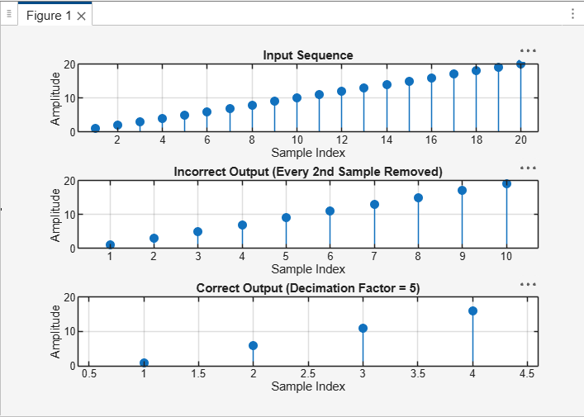
Output

Slide 9
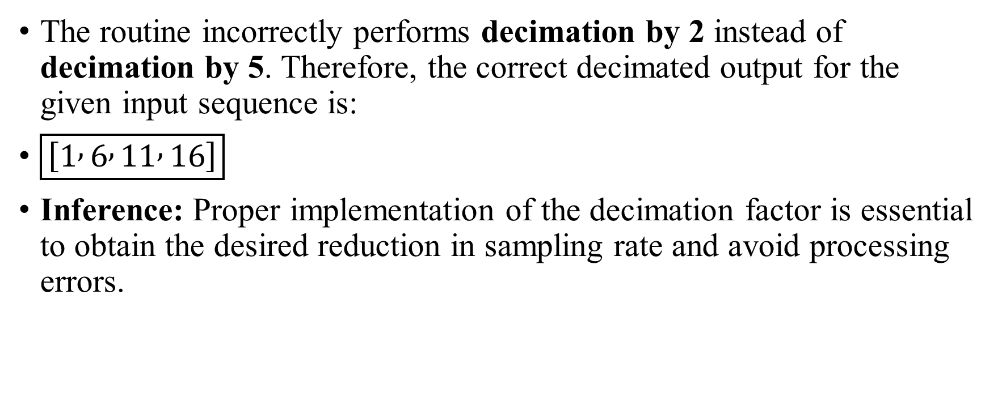
Conclusion
The routine incorrectly performs decimation by 2 instead of decimation by 5. Therefore, the correct decimated output for the given input sequence is:
$\boxed{\left[1 , 6 , 11 , 16\right]}$
Inference: Proper implementation of the decimation factor is essential to obtain the desired reduction in sampling rate and avoid processing errors.

